Slide 1
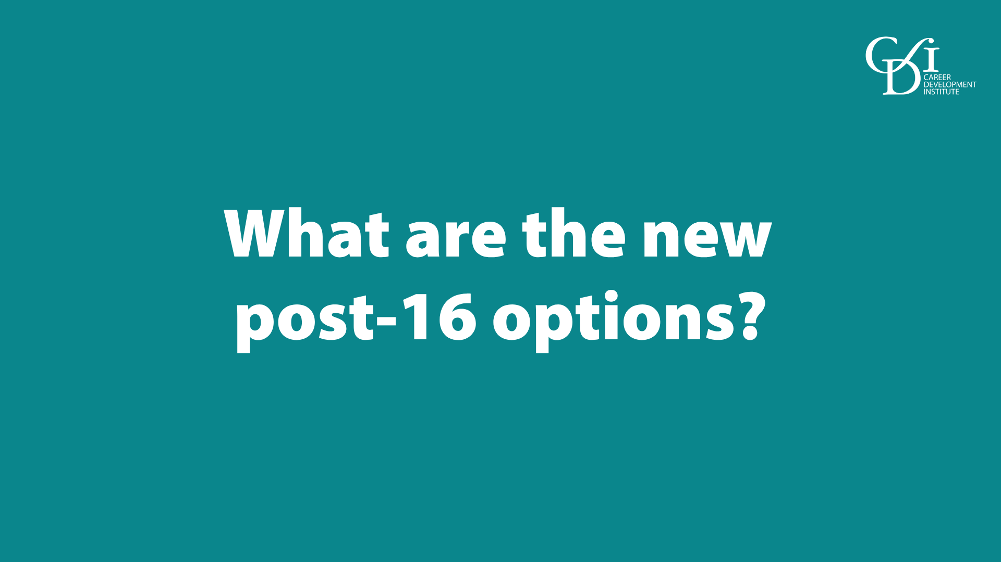
Notes:
Today I want to talk to you briefly about the new options recently announced by the Government for students aged 16.

Slide 2
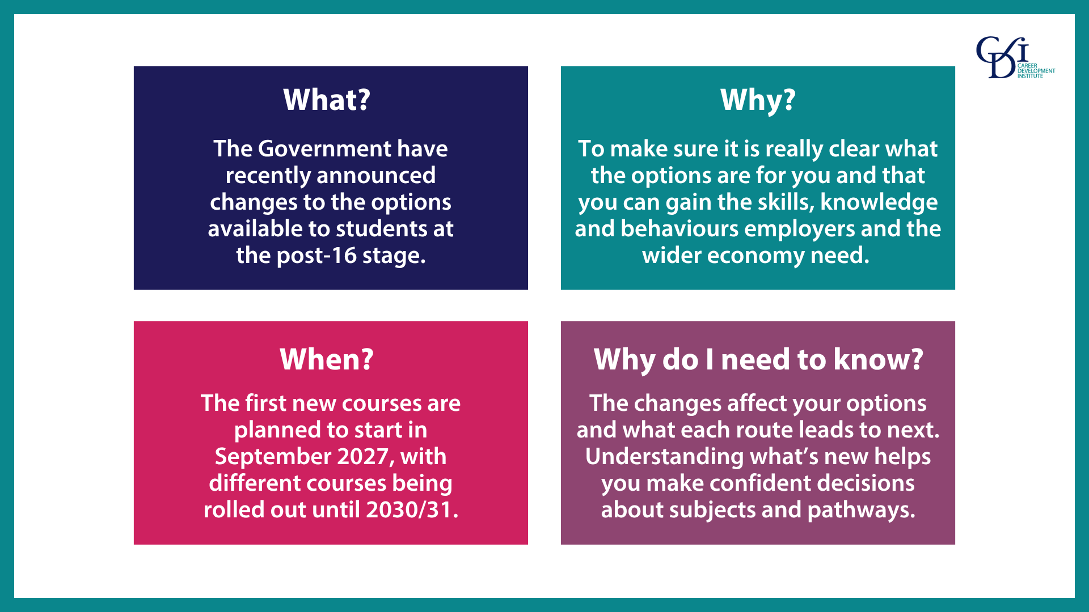
Notes:
The Government has done a great deal of research and consultation on the post-16 options and recently announced changes to what will be available in the future.
The reason they’ve done this is because they felt there were differences between previous courses and the skills employers need now. The changes are happening to make sure what you study matches the real skills, knowledge and behaviours that will be in demand in future jobs.
The delivery of these new options is starting soon - in September 2027 - with courses and subjects being rolled out until 2030/31.
The changes affect your options and what each route leads to next. Understanding what’s new helps you make confident decisions about subjects and pathways.
Note to presenter – please amend the following as appropriate for your setting and the students you are talking to:
As a school/college/training provider, we are planning to offer XXX courses from 2027 / we will not be offering any courses from September 2027, but may in the future.

Slide 3
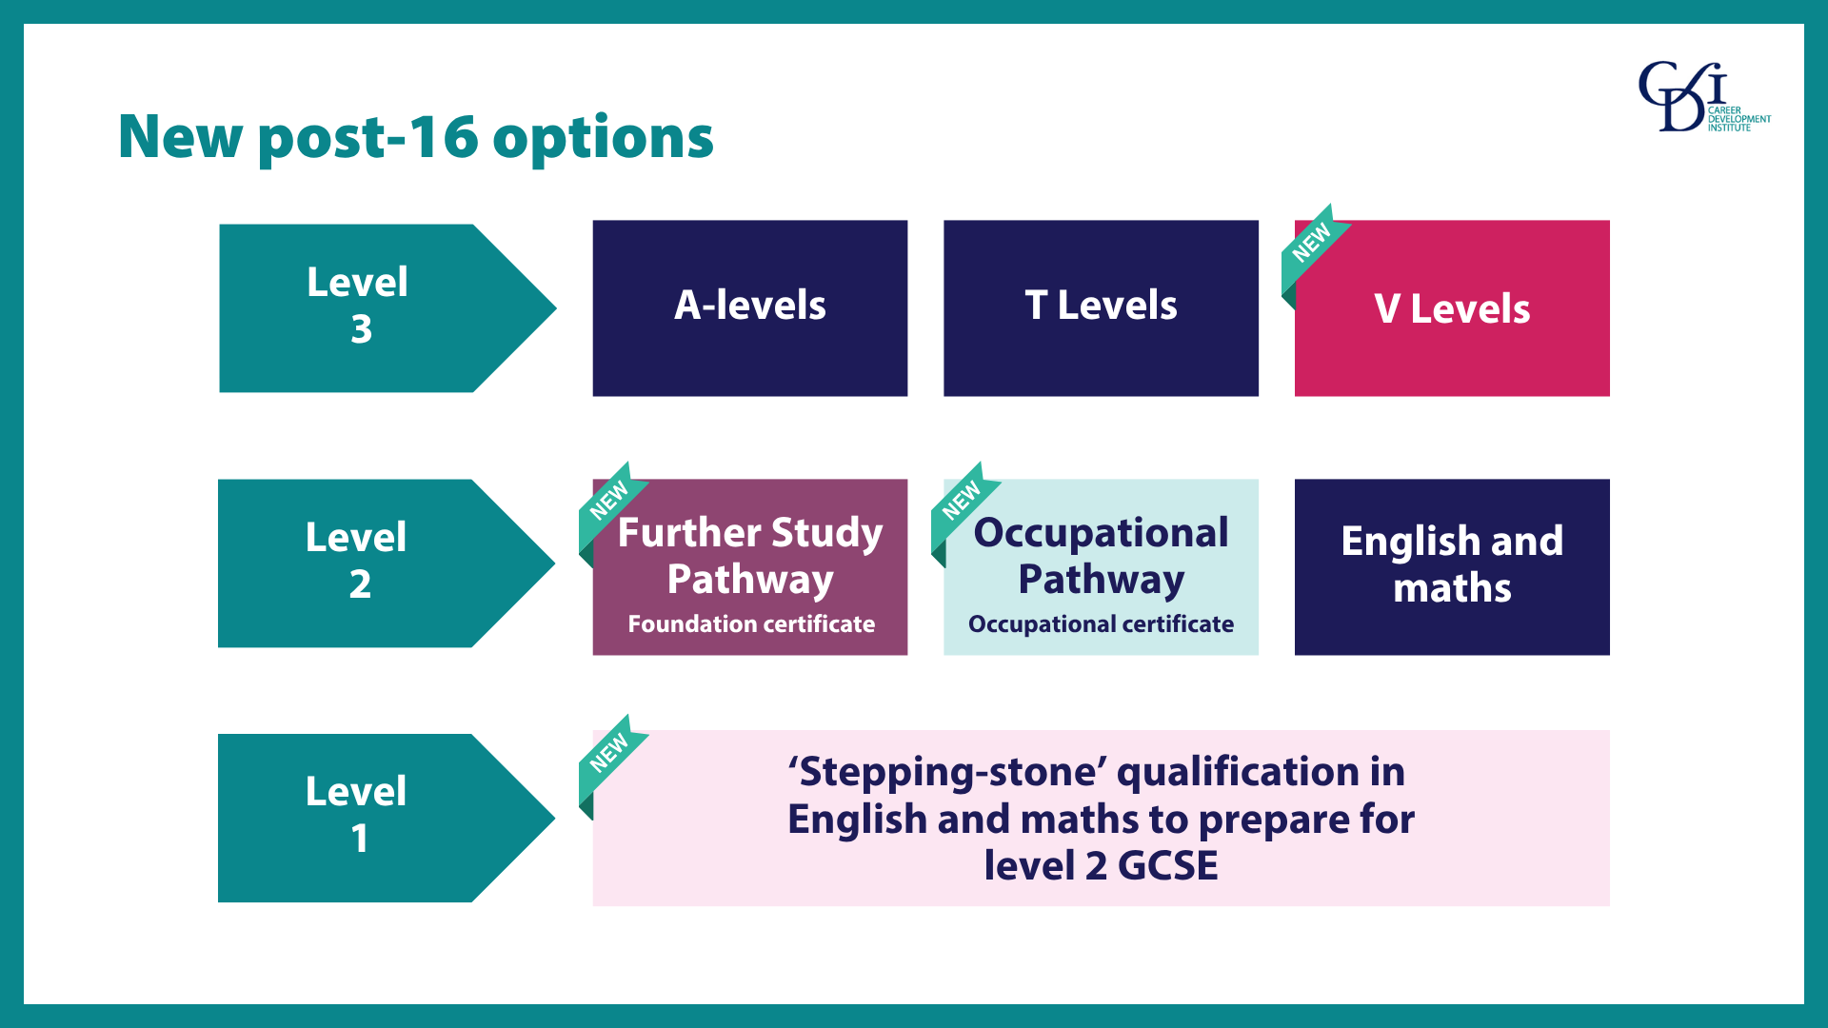
Notes:
What you can see on the screen summarises the new and existing options available at post-16.
At level 3, A-levels and T Levels are joined by V Levels, with the V standing for Vocational and I’ll talk more about those in a minute.
At level 2 there are two new options - one that prepares students for further study at level 3 and another that prepares for specific occupations. Again, I’ll come on to those in a minute.
At level 1, new GCSE-branded English and maths qualifications will be available, as a ‘stepping-stone’ to resitting level 2 GCSE English and maths for those who need to.

Slide 4
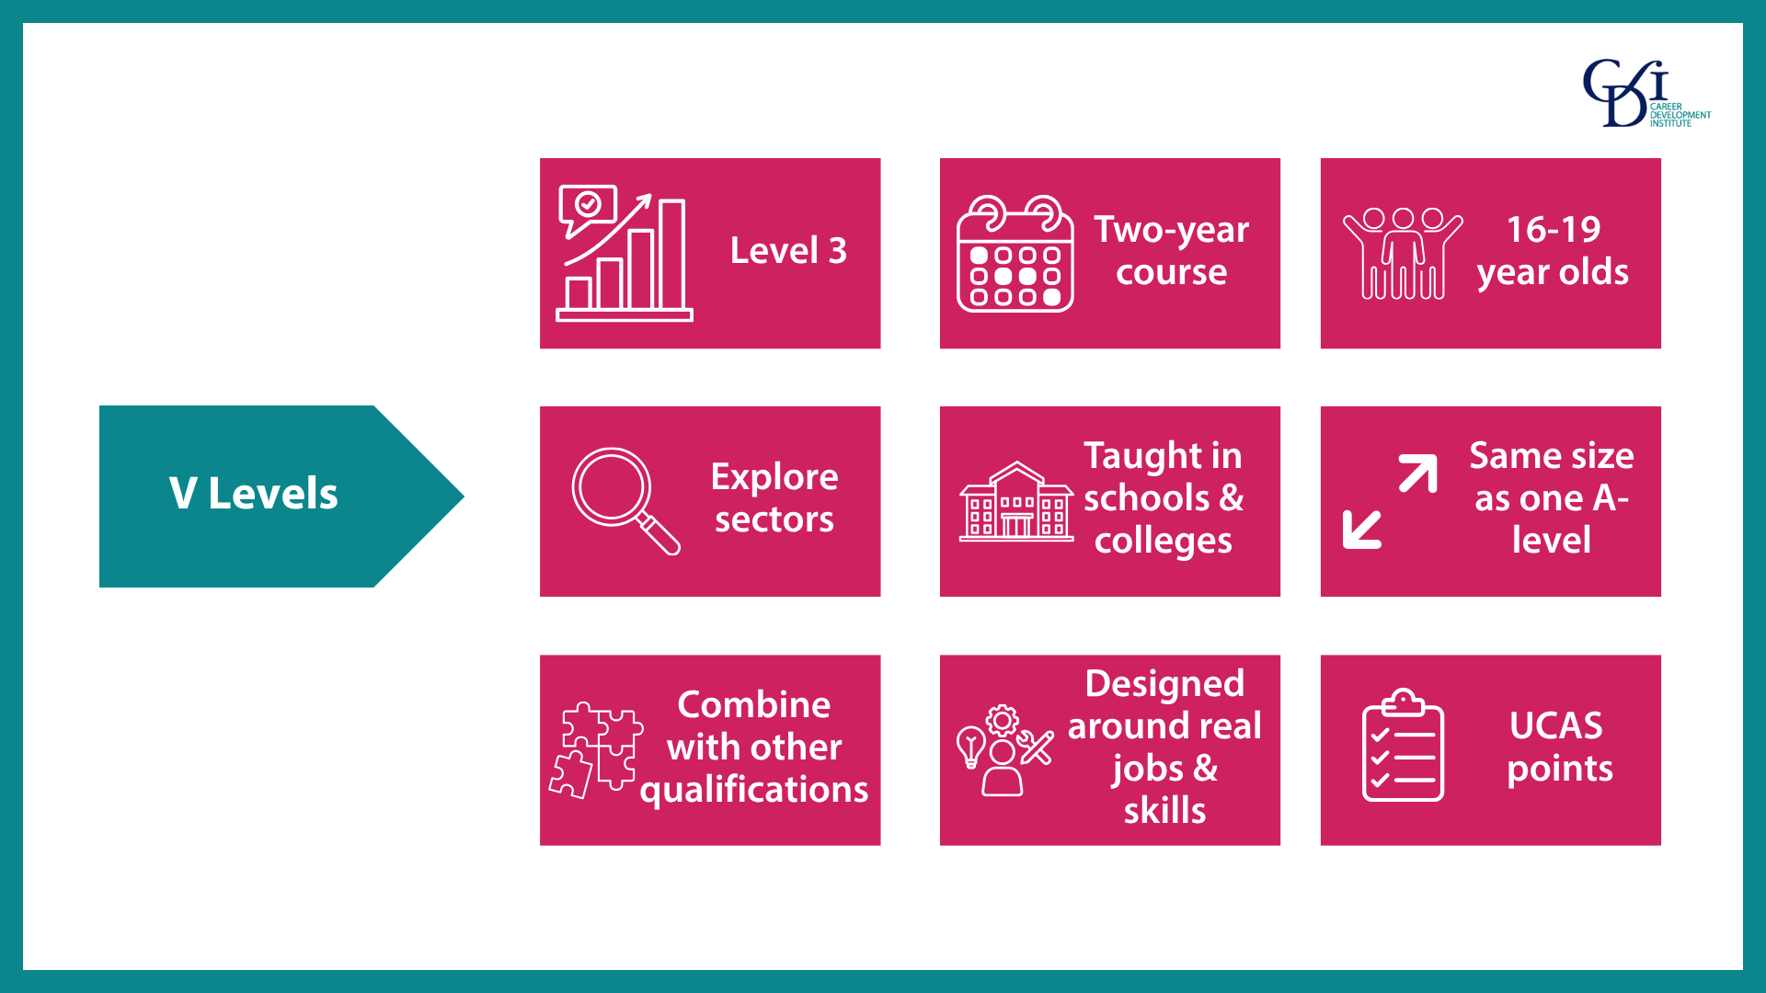
Notes:
You may have heard about V Levels already as they have been in the news quite a lot!
V Levels are level 3, two-year vocational qualifications for 16–19-year-olds who would like to explore sectors without specialising.
They will be taught in schools and colleges and as I mentioned earlier, we will be XXX (note to speaker to add information about if your setting will be offering V Levels or not).
V Levels are similar in size to one A-level and multiple V Levels can be taken in combination with other qualifications such as A-levels or level 2 English or maths. For example, a student could take one V Level and two A-levels. However, V Levels cannot be taken alongside a T Level because a T Level is already the same size as 3 A-levels or 3 V Levels.
The first V Level courses will be available from September 2027 in the subjects: Education & Early Years, Finance & Accounting and Digital.
Everything you learn will be based on the skills you need for real jobs, as part of a framework known as occupational standards - the same ones used in T Levels and apprenticeships, so exactly what employers are looking for.
Most of the assessment won’t take the form of exams - you’ll be assessed through practical, hands‑on tasks that match real vocational work.
V Levels will attract UCAS points, meaning you can use them to apply for higher education courses at universities.

Slide 5
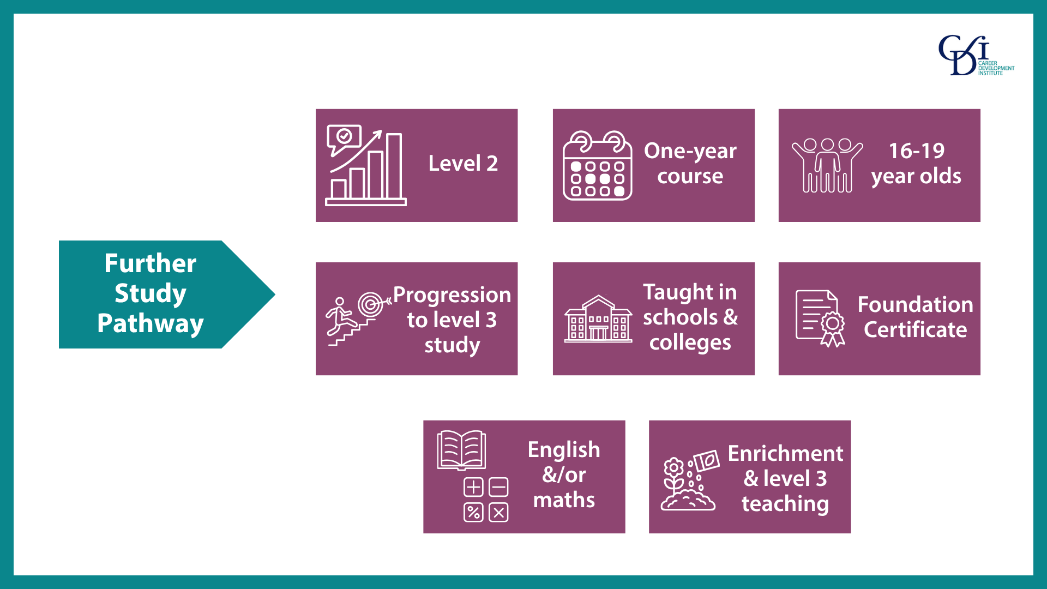
Notes:
The Further Study pathway is a level 2, one-year, classroom‑based programme. Level 2 is roughly the same level as GCSEs.
It has been designed for 16–19-year-olds who want to, and are able to, progress to further study at level 3 such as T Levels, A‑levels or the new V Levels, but need a bit more time and support to be ready to start those level 3 courses.
The Further Study pathway will be delivered in schools and colleges and as I mentioned earlier, we will be XXX (note to speaker to add information about if your setting will be offering this course).
A Foundation Certificate is included as a qualification and the programme also includes English and/or maths if needed, enrichment activities and structured exposure to level 3 teaching to help students build confidence and prepare for the next stage.
So if you want to do A-levels, a T Level or V Levels, but you would benefit from a year of study to get you ready, this could be a really good option for you.

Slide 6
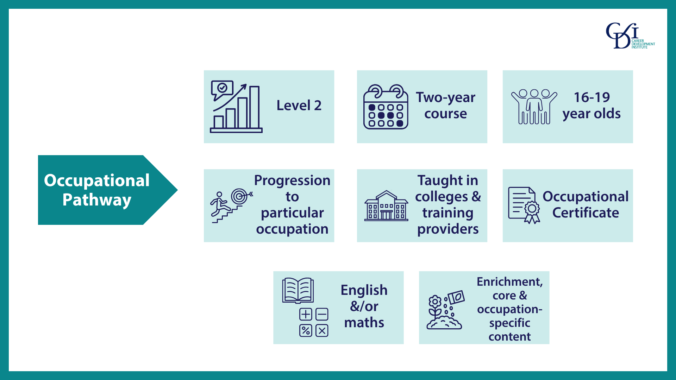
Notes:
The Occupational Pathway is a level 2, two-year classroom‑based programme. As I said, level 2 is roughly the same level as GCSEs.
It is for 16–19-year-olds who want to enter a specific level 2 job and need to develop the technical knowledge and skills required to progress into that role.
The occupational pathway is designed to be delivered in colleges and other training providers rather than in schools, due to access to specialist facilities, equipment and staff expertise that are typically found in Further Education settings.
It includes an Occupational Certificate, as well as English and/or maths if needed, enrichment activities, core content and occupation‑specific learning to prepare students for skilled employment.
This option is going to be really good for students who want to start working, but need a bit more time in college before they do so.

Slide 7
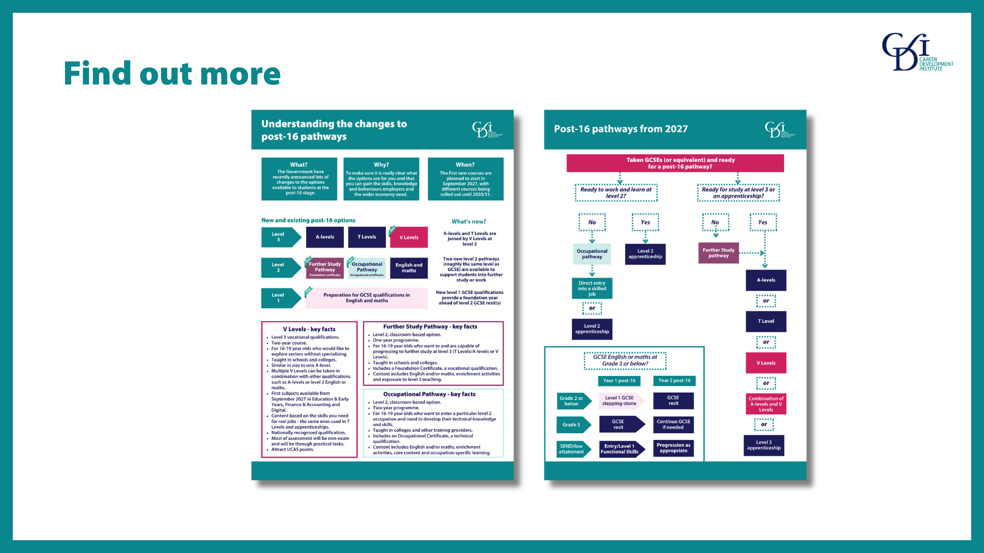
Notes:
After this presentation I will send out a short guide that includes everything we’ve discussed today, as well as a diagram that explains the different options and who they are appropriate for.

Slide 8


