Slide 1

CORE PROGRAMME
Understanding the role and value
of a Careers Leader
ROLE
Day 1
VALUE
Trainer: ______________________
Assessor: _____________________
IMPROVEMENT
CDI Careers Leader Training | Core Day 1 | September 2026 1
Notes:
Welcome delegates and introduce trainer/assessor roles. Position Day 1 as the foundation for the Core programme: understanding the Careers Leader role, why careers matters and how provision connects to organisational priorities. Keep introductions brief.

Slide 2
Welcome to the CDI Careers Leader Training
WELCOME
Careers Leader Training
CDI Careers Leader Training | Core Day 1 | September 2026 2
Notes:
Welcome the group and establish an inclusive, participative tone. Cover practical arrangements, timings and how questions will be handled.

Slide 3
The Five Taught Days
Core Day 1
Core Day 2
Understanding the role and value of a Careers Leader
Designing your Careers Programme
Core Day 3
Extension Day 4
Leading, evaluating and improving your Careers Programme
Leading Career Development Strategically
Extension Day 5
Managing Sustainable Career Development
CDI Careers Leader Training | Core Day 1 | September 2026 3
Notes:
Explain the overall learning journey exactly as shown. Core Days 1–3 establish role, programme design, leadership/evaluation/improvement. Extension Days 4–5 provide greater strategic depth. Avoid teaching Extension content at this stage.

Slide 4
CEC Learning Outcomes
• Understand the purpose and responsibilities of the Careers Leader.
• Understand how careers contributes to whole organisation priorities.
• Recognise the importance of strategic leadership.
• Identify key stakeholders and partnerships.
• Begin planning improvements within their own organisation.
CDI Careers Leader Training | Core Day 1 | September 2026 4
Notes:
Use these outcomes to frame the day. Ask delegates to listen for connections to their own setting.

Slide 5
Today is about…..
Thinking
strategically
Sharing
practice
Challenging
ideas
Planning for
improvement
CDI Careers Leader Training | Core Day 1 | September 2026 5
Notes:
Set expectations for active participation. Emphasise that delegates bring valuable organisational knowledge and will learn from each other. Encourage constructive challenge and application rather than looking for one universal model.

Slide 6
Meet the Group
Name
Organisation
Experience
One challenge
CDI Careers Leader Training | Core Day 1 | September 2026 6
Notes:
Invite each delegate to share the four prompts. Keep this paced. Use the 'one challenge' responses to understand the group and refer back to them during the day where relevant. Can add to workbook page 3

Slide 7
Confidence Check
How confident do you feel today?
1
2
3
4
5
Low confidence
High confidence
CDI Careers Leader Training | Core Day 1 | September 2026 7
Notes:
Use a quick 1–5 confidence rating. Clarify that this is a baseline, not a test. You can revisit it at the end. Ask one or two delegates what would help move their confidence one point. You could use a Teams Poll, or just request that the learners put this into the chat. Explain that there is a confidence wheel in their workbook that they can complete later in the workbook page 4

Slide 8








What do others say….
CDI Training Video Karen
CDI Training Video Ash
CDI Training Video
Will
Notes:
Before playing, ask delegates to listen for what the speakers say about the role, impact and challenges of careers leadership. Afterward, take brief observations. Can add notes in their workbook page 5

Slide 9
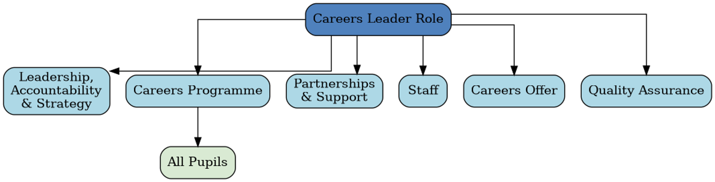
The Role of the Careers Leader
Use the existing accredited Mark Fox resource/video.
Accredited Mark Fox
CDI Careers Leader Training | Core Day 1 | September 2026 9
Notes:
Use the existing Mark Fox accredited resource/video. Ask delegates to note the breadth of the role and any responsibilities that are new or less developed in their own setting.

Slide 10
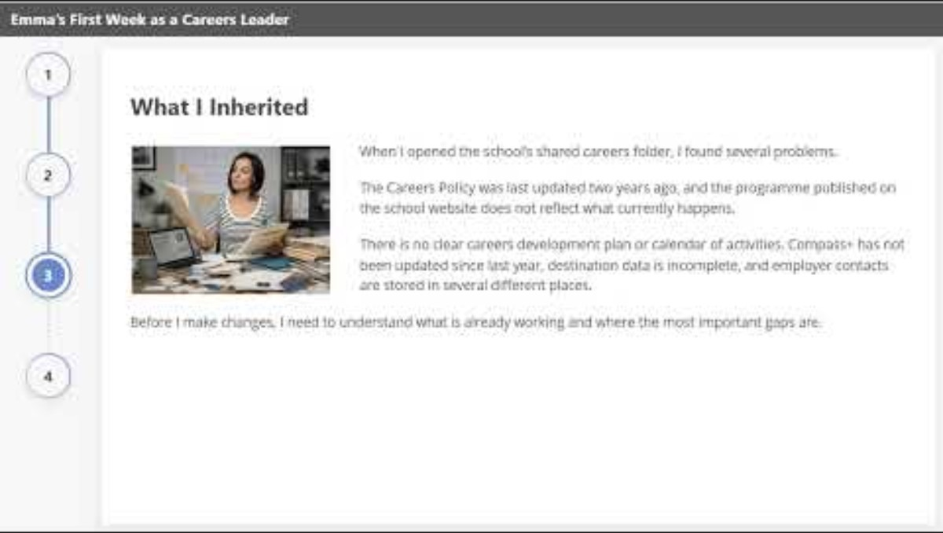
Meet Emma
"You've just started as the Careers Leader at Greenfield Academy”.
Notes:
Use the link for the case study: https://youtu.be/4Gusz-T5G8g The case study is also in the workbook on page 5, and the activity is on page 6. Introduce Emma as a new Careers Leader at Greenfield Academy. Play/open the existing case study. Give delegates 5 minutes individually, then 15 minutes in pairs/groups. Ask them to decide what Emma should do first, what can wait, who she needs to speak to and what evidence she needs. Debrief by grouping answers under evidence, relationships, role clarity and prioritisation.

Slide 11
Universal factors for success
Access to senior leadership
Positional or personal authority and leadership
Expertise
Time
Source – 2019 survey of Careers Leaders CEC
CDI Careers Leader Training | Core Day 1 | September 2026 11
Notes:
Explain each factor and invite examples. Access to senior leadership supports influence and decision-making; authority may be positional or relational/personal; expertise builds credibility; time is necessary for strategic work. Ask which factor is strongest and weakest in delegates' settings.

Slide 12
Models for the Careers Leader role
Middle leader, with senior leader support
Senior leader
Outsourced
Distributed leadership
MAT wide post
Support staff/admin role
(Careers Coordinator)
Benefits Potential Risks
CDI Careers Leader Training | Core Day 1 | September 2026 12
Notes:
Compare the benefits and potential risks of each role model. Ask delegates to discuss and add to their workbook workbook. Make clear that models will be revisited in greater depth in the Extension programme. Activity on 7and 8 in the workbook

Slide 13
Models for delivering career learning
discrete careers lessons
modules of careers education within a PSHE carousel
part of an integrated PSHE course
part of a tutorial programme
cross-curricular approach
curriculum days
CDI Careers Leader Training | Core Day 1 | September 2026 13
Notes:
Introduce the six delivery models exactly as shown. Ask delegates which models they currently use and whether their programme combines approaches. Focus on recognising models at this stage; detailed programme design is developed on Day 2. Activity on page 7/8 in the workbook.

Slide 14
Aligning Institutions Vision & Careers
School/College Goals
Career Strategy Goals
Delivery
Resources
Results
Delivery
Resources
Results
Alignment
CDI Careers Leader Training | Core Day 1 | September 2026 14
Notes:
Explain that careers should not operate as a separate initiative. Ask delegates to identify one institutional goal and how careers delivery, resources and results might contribute. Keep this conceptual; the mission statement activity follows.

Slide 15
Activity – Mission Statement
Yeovil College has a clear mission statement
‘To Create Life-Changing Opportunities’.
Yeovil College Vision
Activity – How does your institution's mission statement align with your career programme?
CDI Careers Leader Training | Core Day 1 | September 2026 15
Notes:
Give delegates time to identify their organisation's mission/vision and make explicit links to careers. Prompt them to move beyond wording: where can they see the mission reflected in learner experience, priorities and provision? So0ace to write comments in their workbook on page 9.

Slide 16
Why does careers matter?
Would careers still matter if Ofsted never inspected it?
CDI Careers Leader Training | Core Day 1 | September 2026 16
Notes:
Use this as a provocative discussion question. The purpose is to move away from compliance as the primary rationale. Invite quick responses and lead into moral purpose.

Slide 17
The Moral Purpose
Opportunity
Equity
Aspiration
Future
Choice
CDI Careers Leader Training | Core Day 1 | September 2026 17
Notes:
Explore each word briefly. Ask delegates what moral purpose means in their context and which learners may benefit most from high-quality career development. Keep discussion grounded in learner opportunity and informed choice.

Slide 18
What does the evidence tell us?
OECD
CDI
Career guidance supports better transitions.
Career development improves lifelong outcomes.
CEC
Skills England
Whole-school approaches have greater impact.
The labour market continues to evolve rapidly.
CDI Careers Leader Training | Core Day 1 | September 2026 18
Notes:
Present these as headline evidence statements from the source deck. Explain that the next activity asks learners to examine research more critically. Avoid adding new research claims beyond what is shown on the slide.

Slide 19
Research Activity
Gatsby
CEC
Careers England
OECD
CDI
In groups, discuss the strengths and limitations of one of these research findings
CDI Careers Leader Training | Core Day 1 | September 2026 19
Notes:
Allocate or let groups select one source/finding. Ask them to identify what the research can reasonably tell us, any limitations, and how it could inform practice. Debrief by stressing that evidence supports professional judgement rather than replacing it. Links and information in their workbook on page 10

Slide 20
BUILD THE CASE
"Why should organisations invest in careers?"
CDI Careers Leader Training | Core Day 1 | September 2026 20
Notes:
Transition from evidence to advocacy. Ask delegates to think about the audience they would need to persuade in their own organisation. Keep responses for the next slide.

Slide 21
Benefits of high-quality careers-related Learning
To individuals
To learning organisations
To business/employers
raised aspirations & confidence
increased motivation
awareness of real opportunities
understanding of the relationship between own skills & labour market needs
improved career management skills
improved ability to progress successfully through key transition points
improved financial literacy
increased entrepreneurship
improved motivation
increased attainment
better programme completion
sustainability
more motivated workforce
greater corporate responsibility
staff committed to training
Better-skilled staff
more creative staff
increased productivity
improved recruitment & retention
sustainability
To the economy
To communities
stronger, more adaptable workforce
reduced unemployment and underemployment
higher productivity and innovation
improved social mobility
better alignment between education, skills and labour market needs
reduced skills shortages and gaps
sustainable economic growth
increased social cohesion
reduced inequality and disadvantage
stronger local identity and resilience
improved well-being and life satisfaction
reduced crime and anti-social behavior
more active citizenship and volunteering, sustainable community development
CDI Careers Leader Training | Core Day 1 | September 2026 21
Notes:
This is a content-rich slide. Do not read every bullet. Allocate different benefit groups to tables or ask delegates to select the two or three benefits most relevant to their setting. Then ask what evidence they could use locally to support those claims.

Slide 22
Making the Case for Careers
Need
Evidence
Benefits
Recommendation
CDI Careers Leader Training | Core Day 1 | September 2026 22
Notes:
Teach this simple structure exactly as shown: Need → Evidence → Benefits → Recommendation. Model a short example verbally, then ask learners to think about a current careers priority in their setting. The activity is in the workbook page 11

Slide 23
Your Organisation
Where are you now?
0%
50%
100%
CDI Careers Leader Training | Core Day 1 | September 2026 23
Notes:
. Ask delegates to place themselves on a continuum and explain what evidence informs that judgement. This can relate to role clarity, strategic alignment or career provision overall.

Slide 24
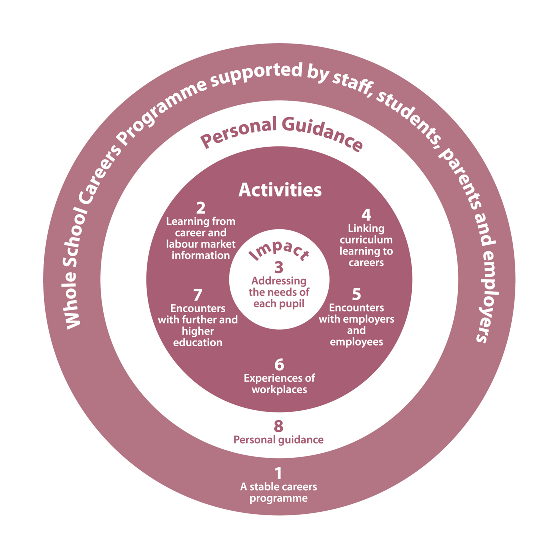
Putting the learner at the centre of Gatsby
LEARNER
Voice
Need
Experience
Impact
CDI Careers Leader Training | Core Day 1 | September 2026 24
Notes:
Introduce the principle that Gatsby implementation should be experienced through the learner, not treated only as organisational compliance. Lead directly into the Aisha case study.

Slide 25
Case Study - Activity: Putting the Learner at the Centre of Gatsby – Meet Aisha
Read the case study:
Question 1
Question 2
How was the learner’s voice included?
Which Gatsby Benchmarks would have the greatest impact on her over the next 12 months?
Question 3
Question 4
What activities would you put in place?
How would you know whether your careers programme had made a difference to Aisha?
CDI Careers Leader Training | Core Day 1 | September 2026 25
Notes:
Use the existing Aisha case study from the learner materials. Give groups time to read or listen before discussing the four questions exactly as shown. Debrief by drawing attention to learner voice influencing decisions, not merely being collected after the activity. Activity is in the workbook on page 12/13

Slide 26
Meaningful Encounters with Work
Traditional work experience
Employer projects
Virtual
Enterprise
Supported internships
CDI Careers Leader Training | Core Day 1 | September 2026 26
Notes:
Introduce the range of meaningful encounters shown. Ask delegates which they use and which learner groups benefit. In your breakout rooms, discuss the following:
Current strengths
Current gaps
One improvement
Keep a detailed employer-engagement strategy for later programme content. You could introduce equalex and the CEC resource - https://www.careersandenterprise.co.uk/modern-work-experience – activity in their workbook page 13

Slide 27
Careers Across the Curriculum
CDI Career Development Framework
CDI Careers Leader Training | Core Day 1 | September 2026 27
Notes:
Ask the delegates to complete a simple mapping extercise in their workbook page 13, think of three subjects and list current links to careers and future opportunities – Page 13 of the work book.

Slide 28

CDI Framework - Career Development Institute
Grow throughout life
Explore possibilities
Manage career
Create opportunities
Balance life and work
See the big picture
CDI Careers Leader Training | Core Day 1 | September 2026 28
Notes:
Talk through the six areas without overloading detail. Ask delegates where these outcomes are already visible in their programme and where there may be gaps. Link to programme design on Day 2. CDI Framework - Career Development Institute

Slide 29


Skills Builder
The Universal Framework
CDI Careers Leader Training | Core Day 1 | September 2026 29
Notes:
Keep the source content intact. Explain that frameworks/tools can help structure reflection and identify gaps, but should be selected for fitness to context. Avoid implying that one tool is mandatory:

Slide 30
How useful are Frameworks and Tools?
Do they assess all the provision?
How easy are they to use?
Do they work for your school/SEND school/College
What’s missing?
How do they help develop gaps?
How does it assist in developing the careers programme?
CDI Careers Leader Training | Core Day 1 | September 2026 30
Notes:
Use these six questions as the discussion structure. Encourage delegates to evaluate tools rather than simply endorse them. Ask for practical examples from different settings, including SEND and college contexts.

Slide 31
Inclusive Careers Provision
How do we ensure every learner can succeed?
Access
Adaptation
Voice
Opportunity
CDI Careers Leader Training | Core Day 1 | September 2026 31
Notes:
Invite delegates to think beyond access to events: consider communication, curriculum, guidance, employer encounters, transitions and individual support. Activity in the workbook Page 14.How inclusive is our provision? What barriers exist?
Three improvements
Lead into Talention

Slide 32
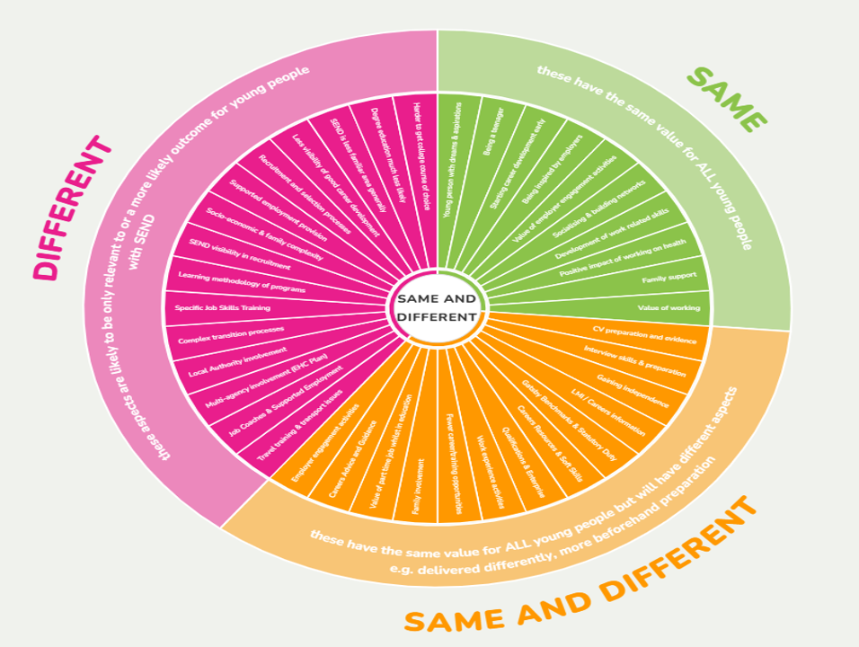
Talentino
Inclusive Careers Education | Talentino!
CDI Careers Leader Training | Core Day 1 | September 2026 32
Notes:
Use the existing Talentino resource/link from the source deck. Explain why it is included: to support thinking about inclusive careers education. Allow brief discussion of how the resource might support their setting.

Slide 33
Improvement Planning
How can planning help me?
CDI Careers Leader Training | Core Day 1 | September 2026 33
Notes:
Transition from understanding the role and provision to improvement planning. Ask delegates what happens when improvement activity is not planned strategically. Complete the table in page 16 of the workbook

Slide 34
Strategic Planning Cycle
Vision
Plan
Deliver
Review
Improve
CDI Careers Leader Training | Core Day 1 | September 2026 34
Notes:
Explain the cycle exactly as shown. Emphasise that review and improvement feed back into vision and planning. Ask delegates where their current practice is strongest and where the cycle tends to break.

Slide 35
Using Compass to inform Strategic Planning
Group discussion:
• How do you complete your Compass/Compass +
• Is it planned or actual
• How do you manage your Compass/+ score
• CEC support
CDI Careers Leader Training | Core Day 1 | September 2026 35
Notes:
Facilitate the group discussion using the exact prompts. Clarify the difference between planned and actual provision where relevant. Encourage delegates to use Compass/Compass+ as evidence for planning, not just as a score to maximise.

Slide 36
Your First 100 Days
0–30
31–60
61–100
What will you understand, discuss or put in place?
What will you understand, discuss or put in place?
What will you understand, discuss or put in place?
CDI Careers Leader Training | Core Day 1 | September 2026 36
Notes:
Using the First 100 Days activity/tool from the learner workbook.. Encourage realistic sequencing and attention to relationships, evidence and organisational priorities. To complete in their own time – Pg 17 of the workbook

Slide 37
Reflection
What surprised you?
What will you do first?
What support do you need?
CDI Careers Leader Training | Core Day 1 | September 2026 38
Notes:
Allow individual reflection before taking optional feedback. Encourage specificity, especially for 'what will you do first?' and 'what support do you need?'.

Slide 38
Professional Practice Challenge
Meet
Discuss
Meet with a senior leader and:
Discuss your careers provision
Identify
Gather
Gather one piece of evidence
Identify one priority
CDI Careers Leader Training | Core Day 1 | September 2026 39
Notes:
Set this as the between-session professional practice challenge exactly as shown. Clarify that the purpose is to connect training to organisational practice and bring evidence/thinking into the next day.

Slide 39
Questions – Now that you have completed Day 1
Question 1
1. What's the most important thing you've learned from the session and your discussions today? Is there something you'd like to celebrate or recognise in your practice?
Question 2
2. Has today highlighted a gap or something you'd like to put in place? What, when and how?
Question 3
3. What support do you need from leadership or others to address immediate priorities? What discussions should you have with your line manager to move forward?
CDI Careers Leader Training | Core Day 1 | September 2026 40
Notes:
Give delegates time to answer the three reflection questions. These should connect to their Reflections and Actions handbook. Encourage honest reflection and concrete next steps rather than polished answers.

Slide 40
Next steps and moving forward
• Review and answer the three questions in your reflections and actions handbook.
• Think about support you would like from your colleagues and the value of WhatsApp, Padlet, etc.
CDI Careers Leader Training | Core Day 1 | September 2026 41
Notes:
Signpost the reflections/actions handbook and peer support mechanisms.

Slide 41
The Careers Leader Toolkit
✔ Organisation Audit
✔ Stakeholder Map
✔ Business Case
✔ Strategic Planning Framework
✔ First 100 Days Plan
CDI Careers Leader Training | Core Day 1 | September 2026 37
Notes:
Recap the tools delegates have encountered or started to build. Explain that the purpose is to create practical resources they can use in their setting. Avoid adding new toolkit items.

Slide 42
Accreditation & Assessment – For Day 1
Unit 18 Assessment Criteria - 18.1.1
Unit 18 Assessment Criteria - 18.3.1
Unit 18 Assessment Criteria - 18.3.2
Unit 19 Assessment Criteria - 19.2.1
Unit 19 Assessment Criteria - 19.3.1
Unit 19 Assessment Criteria - 19.3.2
Introduction
Expectations
Deadlines & Extensions
42
CDI Careers Leader Training | Core Day 1 | September 2026 42
Notes:
Use the current approved assessment guidance when delivering this slide. The visible content has been retained from the source deck, including the listed criteria and 'add recordings' prompt. Explain expectations, deadlines and extensions consistently with current CDI processes; do not improvise assessment requirements.

