Slide 1

CORE PROGRAMME
Leading, Evaluating and Improving
your Careers Programme
COHERENCE
Day 3
EVALUATION
IMPROVEMENT
CDI Careers Leader Training | Core Day 3 | September 2026 1
Notes:
Welcome delegates to Core Day 3. Position today as the final Core day: moving from understanding and design to leading, evaluating and improving. Keep the distinction from Extension clear: Core applies evaluation and improvement tools; Extension later takes leadership and organisational decision-making into greater strategic depth.

Slide 2
Learning Outcomes
1
2
Review the coherence and progression of your careers programme.
Evaluate how effectively career-related learning is meeting learner needs.
3
4
Use evidence to identify strengths, gaps and priorities for improvement.
Evaluate approaches to change and apply them to careers development.
5
6
Plan evidence-informed improvements.
Identify and respond to colleagues' development needs.
7
8
Work with internal and external partners to strengthen delivery.
Evaluate the impact of changes and professional development.
CDI Careers Leader Training | Core Day 3 | September 2026 2
Notes:
Talk through the eight outcomes exactly as in the source. Explain that the day moves through programme coherence, evaluation, change, improvement planning and colleague development.

Slide 3
Our Core Programme Journey
Where are we now? → What do our learners need? → What should we provide? → Is it working? → What needs to improve?
Day 1
Understand
Day 2
Design
Day 3
Lead, Evaluate & Improve
CDI Careers Leader Training | Core Day 3 | September 2026 3
Notes:
Use the journey exactly as shown. Reinforce the progression: Day 1 Understand → Day 2 Design → Day 3 Lead, Evaluate & Improve. The central question is whether provision is working and what needs to improve.

Slide 4

From Planning to Impact
At the end of Day 2, you identified strategic aims for your careers provision.
Choose one of those priorities. Discuss with a partner:
• What was the priority?
• Why did you identify it?
• What evidence informed it?
• What have you done since Day 2?
• Who needs to be involved?
• What evidence informed it?
• How will you know whether it has made a difference?
CDI Careers Leader Training | Core Day 3 | September 2026 4
Notes:
At the end of Day 2 delegates identified strategic aims. Ask them to choose one priority and work through the source questions. Note that 'What evidence informed it?' appears twice in the source; use the second occurrence as an opportunity to ask whether any new evidence has emerged since Day 2 rather than silently changing the visible content. They can add notes in their workbook PG 26

Slide 5
From Provision to Impact
What do we provide?
Who participates?
What do learners experience?
What do learners learn or develop?
What difference does it make?
A busy careers programme is not necessarily an effective careers programme.
CDI Careers Leader Training | Core Day 3 | September 2026 5
Notes:
Teach the progression from provision to impact. Explain the difference between activity/output and learning/outcome. Use the source statement: a busy careers programme is not necessarily an effective careers programme.

Slide 6
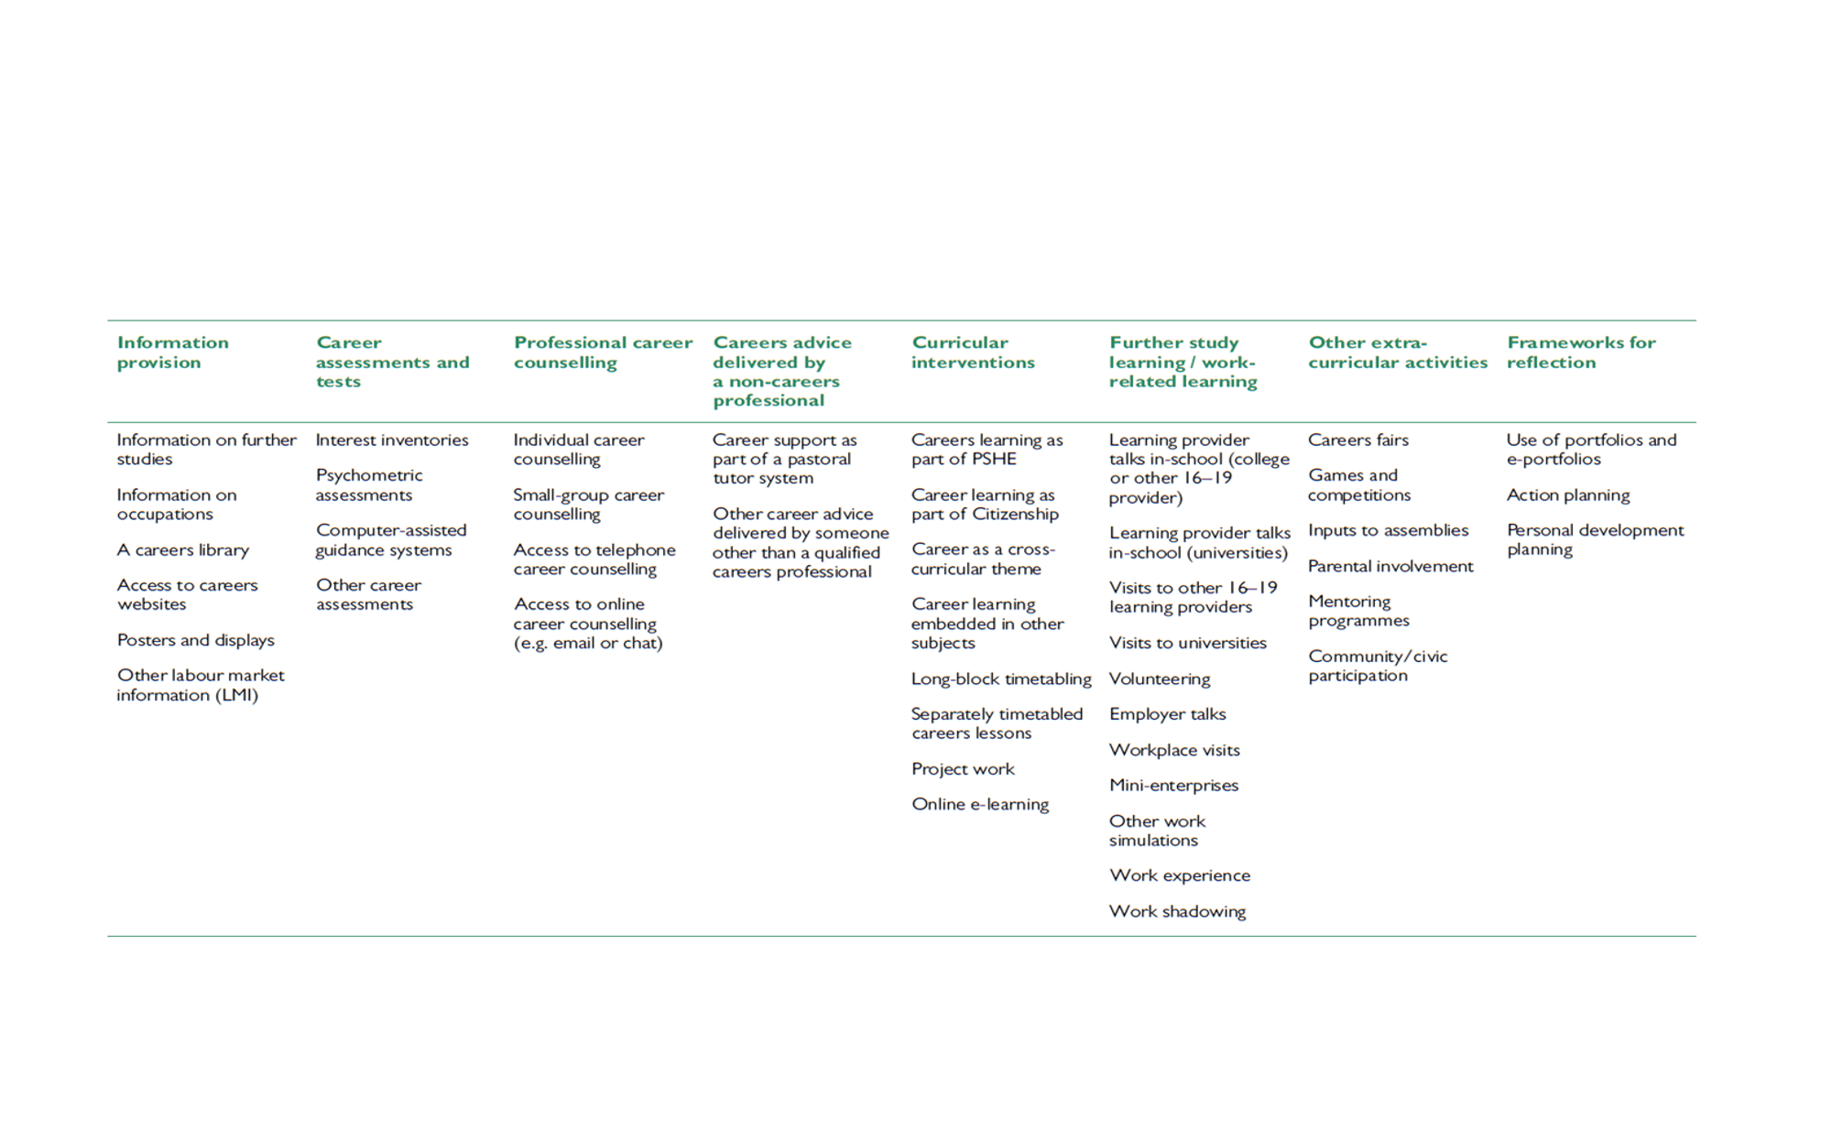
Strands of delivery – building a coherent whole
A Careers Leader is not simply responsible for individual activities.
The role is to make sure the different strands connect into a coherent learner journey.
CDI Careers Leader Training | Core Day 3 | September 2026 6
Notes:
Use the source message: a Careers Leader is not simply responsible for individual activities; the role is to make sure different strands connect into a coherent learner journey. Ask delegates what strands make up their programme.

Slide 7






Aims of career related learning
Grow throughout life
Explore possibilities
By learning and reflecting on yourself, your background and your strengths
Explore the full range of possibilities open to you and learn about recruitment processes and the culture of different workplaces
Manage career
Create opportunities
Manage your career actively, make the most of opportunities and learn from setbacks
Create opportunities by being proactive and building positive relationships with others
Balance life and work
See the big picture
Balance your life as a worker and/or an entrepreneur with your wellbeing, other interests and your involvement with family and community
See the big picture by paying attention to how the economy, politics and society connect with your own life and career
CDI Careers Leader Training | Core Day 3 | September 2026 7
Notes:
Revisit the six CDI Career Development Framework areas from the source. Do not reteach the framework in full; use it as a lens for checking whether programme learning is broad and progressive.

Slide 8


Risks
What is the difference between a collection of careers activities and a progressive careers programme?
CDI Careers Leader Training | Core Day 3 | September 2026 8
Notes:
Use 'Blizzard of activities' as the key risk. Ask delegates what this looks like in practice: lots of events, repetition, weak sequencing, unclear outcomes or inequitable access. Lead directly into the coherence question.

Slide 9
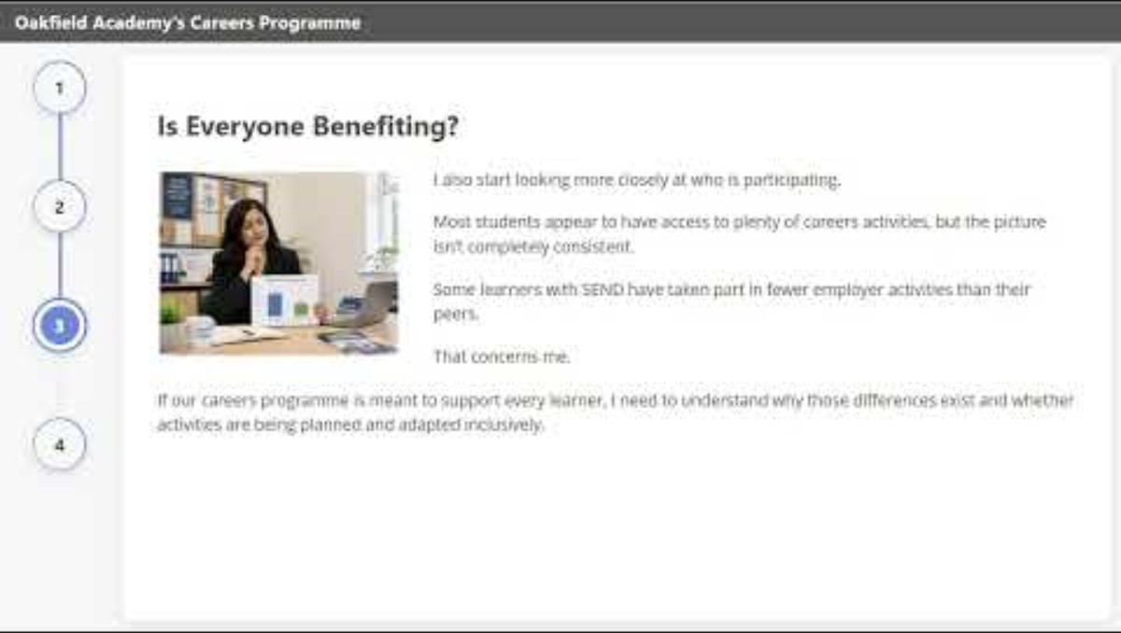
Case Study 1: Oakfield Academy
Lots happening – but is it a programme?
Activity
Progression
Coherence
Inclusion
CDI Careers Leader Training | Core Day 3 | September 2026 9
Notes:
Use the Oakfield Academy case study from the learner workbook PG 27. The source framing is 'Lots happening – but is it a programme?' Ask learners to identify evidence of activity, progression, coherence, inclusion and learning outcomes. Here is the link to the case study: https://youtu.be/xnTcCUxDiKI

Slide 10
Activity – Reviewing your programme
What are the pros and cons of your current delivery model?
How coherent is your provision across year groups or phases?
Which groups of learners may not be fully included?
CDI Careers Leader Training | Core Day 3 | September 2026 11
Notes:
Ask delegates to independently review their programme using the three source questions. Encourage evidence-based reflection rather than general impressions. Space for review page 28 of the workbook.

Slide 11
Gatsby Benchmark 4: Linking curriculum learning to careers
What makes Gatsby 4 particularly dependent on other colleagues?
CDI Careers Leader Training | Core Day 3 | September 2026 12
Notes:
what makes Gatsby 4 particularly dependent on other colleagues? Draw out subject expertise, curriculum ownership, teacher confidence and whole-school consistency. Keep this at Core programme-design level. Activity in the workbook for them to complete PG 29: they need to complete the activity and then review what makes GB4 particularly dependent on other colleagues, one action they could take to strengthen GB4

Slide 12


Skills Builder – Framework
The Universal Framework
CDI Careers Leader Training | Core Day 3 | September 2026 13
Notes:
Revisit the Universal Framework as in the source. Ask how it can support a coherent programme and how it connects to curriculum learning. Avoid adding new framework content not present in the source. Can use as a discussion, they can add notes to their workbook after the Talentino slide split into groups to discuss either skills builder or Talentino

Slide 13


Talentino - Careers at Every Level
CDI Careers Leader Training | Core Day 3 | September 2026 14
Notes:
Revisit Talentino as an inclusive careers education resource. Split into groups to complete the activities for Skills builder or Talentino PG 30 and 31

Slide 14
PSHE / RSHE Framework
The renewed Ofsted Framework – five key considerations for PSHE/RSHE leads and school leaders
CDI Careers Leader Training | Core Day 3 | September 2026 15
Notes:
Use the existing PSHE/RSHE framework resource and the source reference to the renewed Ofsted Framework's five key considerations for PSHE/RSHE leads and school leaders. Keep this as a programme-design connection rather than expanding into an Ofsted briefing. The renewed Ofsted Framework – five key considerations for PSHE/RSHE leads and school leaders
In the workbook PG32 they are asked to consider the following: Where does career learning currently sit within PSHE/RSHE? What career-related learning is already being delivered through PSHE/RSHE? Where is there overlap with other parts of the curriculum? Are there any gaps? Is there any unnecessary repetition? Who should you work with to improve alignment?
Where is there an opportunity to strengthen the connection between careers and PSHE/RSHE?
What would be the benefit for learners?

Slide 15
Designing a careers education programme
Content
Differentiation
Career Guidance Theory
Teaching methods/delivery
Assessment and accreditation (if appropriate)
Timing of activities
Curriculum location
Monitoring, review & evaluation
The design should begin with intended learning – not the activity
CDI Careers Leader Training | Core Day 3 | September 2026 16
Notes:
Teach the eight design considerations. Emphasise the source statement: design should begin with intended learning – not the activity. They can complete the activity in their workbook PG 33, this can be done after the training if there is not enough time.

Slide 16
A Framework for Curriculum Planning
Curriculum planning
Identifying students’ career learning needs
(2)
Define aims, curriculum objectives and learning outcomes
(3)
Design a careers education programme and plan how to deliver it
(4)
Assess students’ learning
(5)
Curriculum development
Monitor, review and evaluate the careers education curriculum
(6)
Plan how to improve the provision (7)
CDI Careers Leader Training | Core Day 3 | September 2026 17
Notes:
Talk through the seven-stage source framework: review provision/practice; identify learner needs; define aims/objectives/outcomes; design/deliver; assess learning; monitor/review/evaluate; plan improvement. Explain that curriculum planning and development are cyclical. There are activities in the workbook 35 and 36 for curriculum planning and Spiral curriculum again this can be completed after the course. Unless there is time to complete in groups.

Slide 17
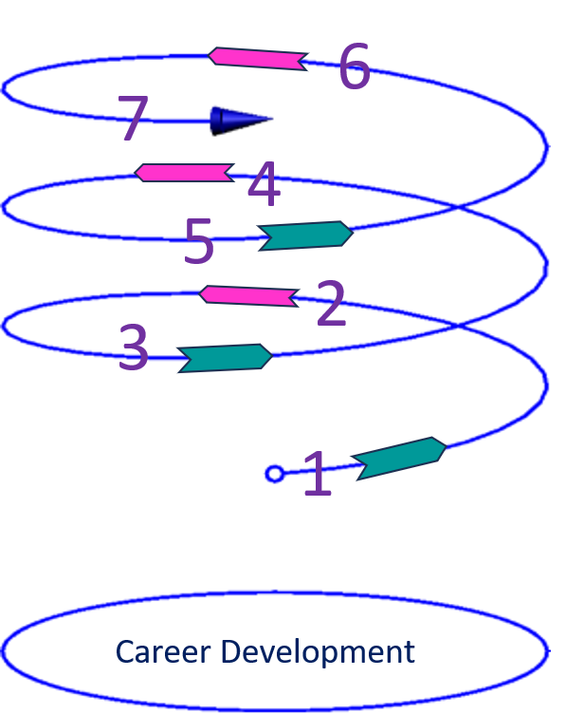
A progressive spiral curriculum
Developing awareness of career
Encountering information
Having experiences
Reflecting on learning
Building understanding
Developing plans and strengths
Putting into practice
CDI Careers Leader Training | Core Day 3 | September 2026 18
Notes:
Explain the source sequence as a progression rather than a one-off set of activities. Ask where learners revisit and deepen learning over time.

Slide 18
From Activity to Learning Outcome
"What do our Year 9 learners need to know, understand and be able to do?"
CDI Careers Leader Training | Core Day 3 | September 2026 19
Notes:
Use the source Year 9 question in the workbook to shift thinking from activities to intended learning. Ask delegates to take one existing activity and state what learners need to know, understand and be able to do. The activity asks the delegates to think about the following: What do these learners need? What do they know? What should they understand? What should they be able to do? What learning outcome should you set? What activity would support that outcome? How would you assess whether the learning has taken place? PG 37

Slide 19

Activity 3 – Test Your Own Programme
CDI Careers Leader Training | Core Day 3 | September 2026 20
Notes:
Use the Test Your Own Programme activity in the workbook. Ask delegates to test coherence, progression, inclusion and intended learning using the preceding taught content for one part of their existing programme PG 38

Slide 20
Activity 5 - What is Evaluation
What
How
Why
Then report back your thoughts
CDI Careers Leader Training | Core Day 3 | September 2026 21
Notes:
Ask delegates to discuss what evaluation is before giving a definition. Use the source prompts What / How / Why and then report back their thoughts. Notes can be made in the work book PG 39

Slide 21
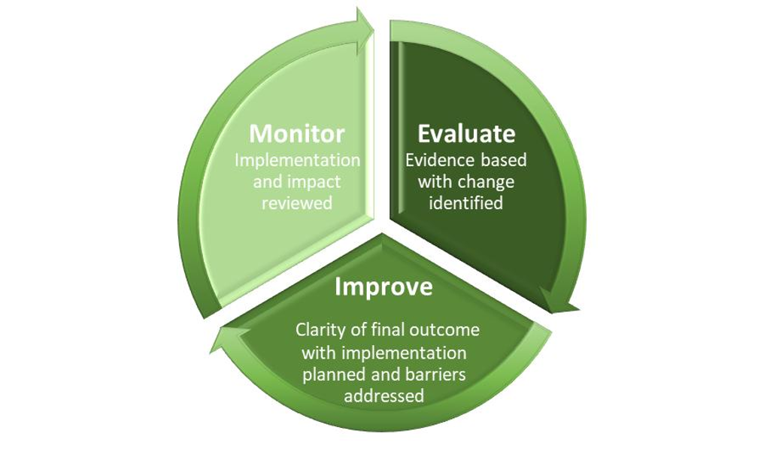
The purpose of evaluation
Evaluation should result in action.
CDI Careers Leader Training | Core Day 3 | September 2026 22
Notes:
Use the source statement: Evaluation should result in action. Explain that evaluation is purposeful evidence gathering and judgement used to improve provision, not data collection for its own sake.

Slide 22
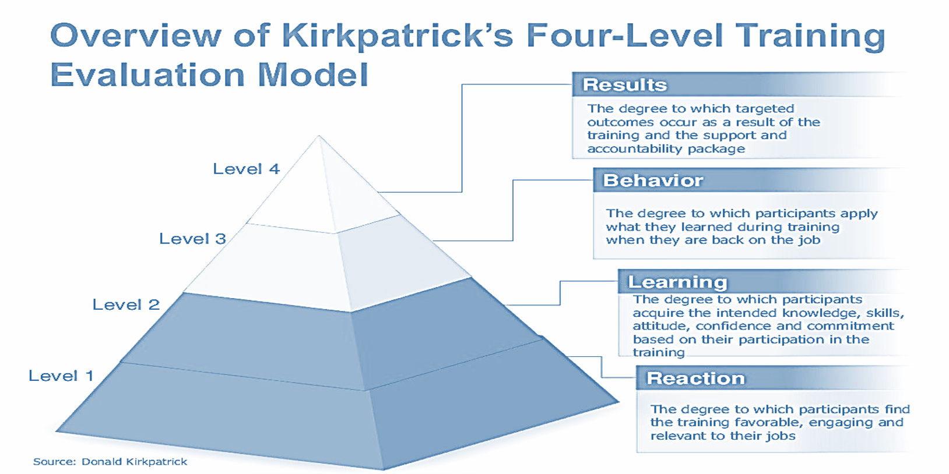
Kirkpatrick’s Model
CDI Careers Leader Training | Core Day 3 | September 2026 23
Notes:
Use the existing Kirkpatrick model resource from the source deck. Explain the levels in the way the programme materials intend, and ask what different evidence would be needed at each level. Keep this applied to careers provision.

Slide 23
Case Study 2: "Our Careers Programme Is Successful"
Riverside College
Last year:
• 96% of learners had an employer encounter.
• 450 attended the careers fair.
• 180 completed work experience.
• 92% enjoyed the careers fair.
• Seven Gatsby Benchmarks are being met.
• 38 employers supported activities.
The Careers Leader reports: “This demonstrates that our careers programme is highly effective.”
Do you agree?
CDI Careers Leader Training | Core Day 3 | September 2026 24
Notes:
Facilitate the Riverside College case exactly from the source. The key learning is that participation, satisfaction and benchmark achievement do not alone demonstrate impact. Ask what the data does show, what it does not show and what additional evidence is needed. Split into groups to complete the activity PG 40 of the workbook. Split into groups to complete the activity.

Slide 24
Case Study 3: Meadow View School
“Careers is important, but we already have too much curriculum content to cover."
CDI Careers Leader Training | Core Day 3 | September 2026 26
Notes:
Use the statement as the change/resistance case. Ask delegates what may lie behind the response and how they could use evidence, relationships, and a manageable-change approach. Put them into groups to discuss. Workbook page 41

Slide 25

Dimensions of resistance
Organisational level
Individual level
uncertainty and insecurity, selective perception, habit, protection of material interests, mistrust based on bad past experience
power and conflict, functional orientation, mechanistic structure, culture
Group level
norms, cohesiveness, groupthink
CDI Careers Leader Training | Core Day 3 | September 2026 27
Notes:
Teach the three source dimensions: organisational, group and individual. Use the listed examples and ask delegates to identify which dimension may be present in Meadow View or their own change context.

Slide 26
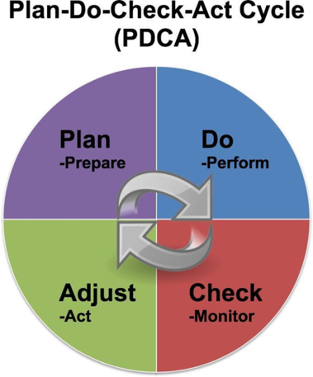
Plan-do-check-act model (1)
Plan
recognise or identify an opportunity and plan for change
Check
review the results and analyse them for success or needed adaptations
Do
Implement the plan for change on a small scale – test the change
Act
if the plan worked, implement the changes on a wider scale; if unsuccessful, go through the cycle again with a different plan
CDI Careers Leader Training | Core Day 3 | September 2026 28
Notes:
Teach PDCA using the exact source stages. Explain its usefulness for testing a change on a small scale and adapting before wider implementation.

Slide 27
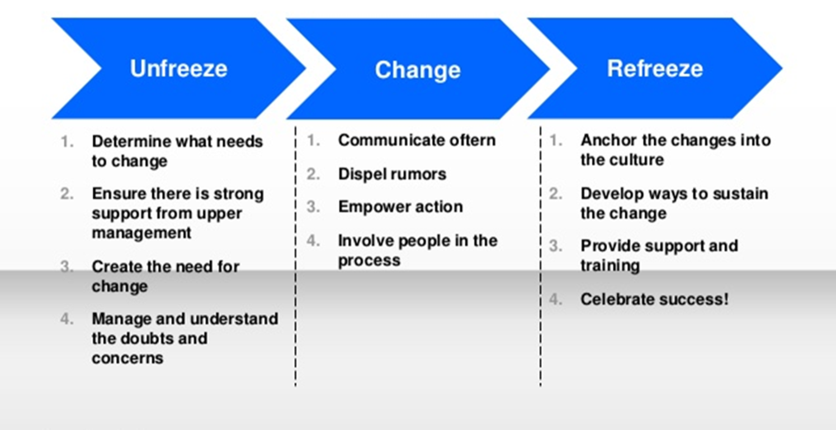
Lewin’s three stage model
CDI Careers Leader Training | Core Day 3 | September 2026 29
Notes:
Use the existing Lewin model visual/resource from the source deck. Explain the three stages as presented in the programme materials and ask delegates where resistance/support may need attention at each stage.

Slide 28
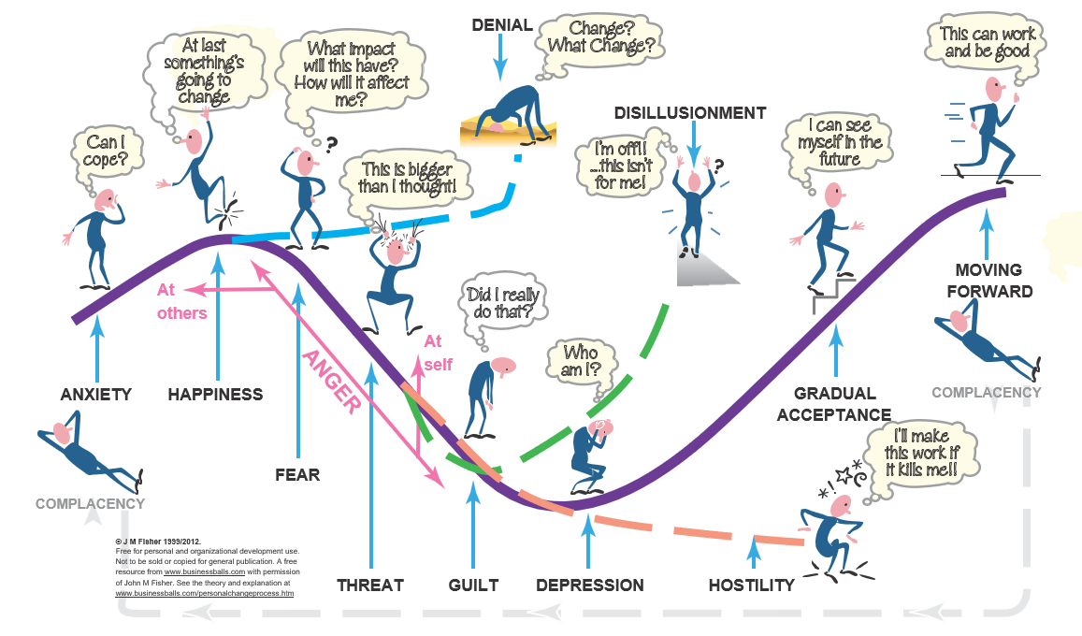
The Process of Transition - John Fisher, 2012
Anxiety
Happiness
Fear
Threat
Guilt
Depression
Moving forward
Fisher’s Personal Transition Curve
CDI Careers Leader Training | Core Day 3 | September 2026 30
Notes:
Use the existing Fisher Personal Transition Curve visual from the source deck, including its attribution. Explain that individuals may experience change differently and not in a neat linear sequence. Use it to consider support during change.

Slide 29
Activity – Leading change
• Think about how you would handle change.
• What barriers might you face (individual, group, organisational)?
• Which change model (Lewin, PDCA, Fisher’s Transition Curve) resonates most with your organisation?
• What will you do about work experience?
CDI Careers Leader Training | Core Day 3 | September 2026 31
Notes:
Use the source prompts. Ask delegates to think about a real change, the barriers at the individual/group/organisational levels, and which of Lewin, PDCA, or Fisher resonates most. The source also asks 'What will you do about work experience?' — retain this as a practical prompt.

Slide 30
Turning Evidence into an Improvement Plan
An improvement plan should include?
Recommendations should be justified by evidence – not preference.
CDI Careers Leader Training | Core Day 3 | September 2026 32
Notes:
Ask delegates what an improvement plan should include Reinforce the statement: recommendations should be justified by evidence – not preference. They can make notes in the workbook PG41

Slide 31
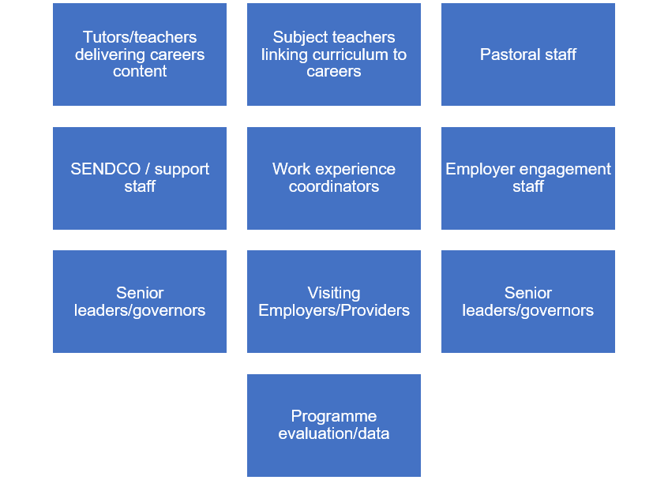
CPD and Training Needs Analysis (TNA)
Audiences
Survey or Poll
using MS Forms/Google Forms to ask staff about confidence with careers tasks (e.g., Gatsby 4, signposting, linking curriculum to careers)
Observation or Learning Walks
noticing how careers is embedded in lessons, tutor time, or pastoral practice
Interviews or Conversations
brief discussions during staff meetings or department meetings
Document Reviews
looking at schemes of work, tutor programmes, or staff handbooks to see gaps
CDI Careers Leader Training | Core Day 3 | September 2026 33
Notes:
Teach the source methods for analysing training needs. Explain that different methods provide different evidence. Ask which method is realistic and proportionate in delegates' settings.

Slide 32
Different Ways to Develop Colleagues
Development Doesn't Always Mean a Training Course
CDI Careers Leader Training | Core Day 3 | September 2026 35
Notes:
Development Doesn't Always Mean a Training Course. Ask delegates for alternatives such as coaching, modelling, resources, peer support or briefing only where these arise naturally from discussion; do not add them as formal source content. They can make notes in their workbook PG 43

Slide 33
Activity – Planning training
Post in the chat a draft one-sentence training need and a matching training activity, e.g.:
Example
“Teaching staff lack confidence in delivering careers learning (Gatsby 4), so I will run a 30-minute training session on linking classroom topics to real-world roles.”
• Reflect on the justification for your proposed training:
• Which need was identified in the TNA
• How the training directly responds to that gap
• What outcomes they expect for individuals and the organisation
CDI Careers Leader Training | Core Day 3 | September 2026 36
Notes:
Use th example and reflection questions. Ask delegates to draft one sentence linking a training need to a matching activity, then justify it using TNA evidence and intended individual/organisational outcomes. Ask the group to complete this as an individual activity PG 44 in the workbook.

Slide 34
Continuous Improvement Cycle
Evidence
Review
Prioritise
Act
Evaluate
Continuous improvement is not a once-a-year activity.
CDI Careers Leader Training | Core Day 3 | September 2026 37
Notes:
Use t continuous improvement is not a once-a-year activity. Connect evaluation, improvement action, colleague development and re-evaluation into an ongoing cycle.

Slide 35
Professional Practice Challenge
Take one action from your improvement plan
1
3
What did you do?
What did you learn?
2
4
What happened?
What needs to happen next?
CDI Careers Leader Training | Core Day 3 | September 2026 38
Notes:
Set the source challenge exactly: take one action from the improvement plan and record what was done, what happened, what was learned and what needs to happen next.

Slide 36
Reflective questions
Question 1
1. What's the most important thing you learned from today's session and discussions? Is there something you'd like to celebrate or recognise in your practice?
Question 2
2. Has today highlighted a gap or something you'd like to implement? What, when and how?
Question 3
3. What support do you need from leadership or others to address immediate priorities? What discussions should you have with your line manager to move forward?
CDI Careers Leader Training | Core Day 3 | September 2026 39
Notes:
Allow individual reflection using the three source questions. Encourage concrete actions and support needs. These reflections should link to delegates' ongoing practice and programme improvement.

Slide 37
Extension programme
For those of you going on to day 1 of the Extension programme, you will need to read the case studies in the extension workbook to participate in the training activities.
CDI Careers Leader Training | Core Day 3 | September 2026 40

Slide 38
Accreditation and Assessment
Unit 18 Assessment Criteria - 18.4.1
Unit 18 Assessment Criteria - 18.4.2 / 18.4.3
Unit 18 Assessment Criteria - 18.5.1 / 18.5.2 / 18.5.3
Unit 19 Assessment Criteria - 19.4.1
Unit 19 Assessment Criteria - 19.6.2 -
Unit 19 Assessment Criteria - 19.7.1
Unit 19 Assessment Criteria - 19.7.2
CDI Careers Leader Training | Core Day 3 | September 2026 40

