Slide 1

CORE PROGRAMME
Designing Career Learning
Programmes
THEORY
Day 2
LMI
Building on your understanding of the Careers Leader role from Day 1
PARTNERSHIPS
CDI Careers Leader Training | Core Day 2 | September 2026 1
Notes:
Welcome delegates to Day 2. The source deck focuses on designing an effective careers learning programme, building on Day 1. Explain that today's content covers theory, professional responsibilities, progression, LMI and partnerships.

Slide 2
Designing Careers Programmes
Welcome to Day 2
Focuses on designing an effective careers learning programme.
Building on your understanding of the Careers Leader role from Day 1
CDI Careers Leader Training | Core Day 2 | September 2026 2
Notes:
Day 2 focuses on designing an effective careers learning programme and builds on delegates' understanding of the Careers Leader role from Day 1. designing an effective careers learning programme and builds on delegates' understanding of the Careers Leader role from Day 1.

Slide 3
Learning Outcomes
Apply career learning theories
Understand professional responsibilities
Design career learning
Plan progression
Integrate Labour Market Information
Develop partnerships
CDI Careers Leader Training | Core Day 2 | September 2026 3
Notes:
Talk through the six outcomes. Ask delegates which feels most familiar and which is likely to be most useful.

Slide 4
What have you changed
Complete the sentence
"Since Day One I have..."
Teams Poll
CDI Careers Leader Training | Core Day 2 | September 2026 4
Notes:
Use this as the Day 1 reconnect. Ask delegates to complete the sentence and share examples.

Slide 5
Professional Practice Challenge
What happened after your discussion with your senior leader?
CDI Careers Leader Training | Core Day 2 | September 2026 5
Notes:
Ask: what happened after your discussion with your senior leader? Invite delegates to share what they discussed and any priority identified. Notes can be made in their workbook PG 19

Slide 6
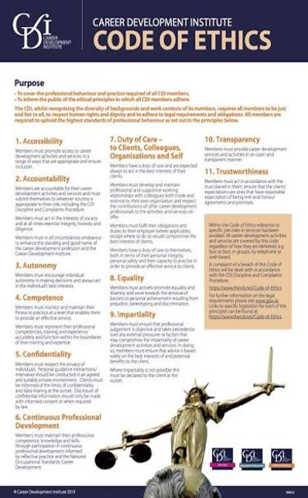





Professional Standards
CDI Careers Leader Training | Core Day 2 | September 2026 6
Notes:
Introduce professional standards as the foundation for ethical and responsible careers leadership. The next slide contains the specific source content.

Slide 7
Professional Standards and Ethics - Activity
Professional Standards in Education
CDI Code of Ethics – Key Principles
Uphold high-quality teaching, learning & assessment
Maintain evidence-based practice
Commit to CPD (Continuing Professional Development)
Promote inclusivity, equality & safeguarding
Collaborate across schools, colleges, employers & agencies
Client-centred practice → act in the best interests of learners
Impartiality → provide unbiased, balanced guidance
Confidentiality → respect privacy and data protection
Transparency → be open about boundaries and limitations
Professional Integrity → honest, accountable, evidence-led
Respect & Equality → promote diversity, fairness and inclusion
CDI Careers Leader Training | Core Day 2 | September 2026 7
Notes:
Work through both columns. Ask delegates to identify where these principles show up in careers programme design.

Slide 8
Reflection
Complete Professional Standards self-audit
CDI Careers Leader Training | Core Day 2 | September 2026 8
Notes:
Ask delegates to complete the Professional Standards self-audit in the learner handbook PG 19. Allow quiet individual time.

Slide 9
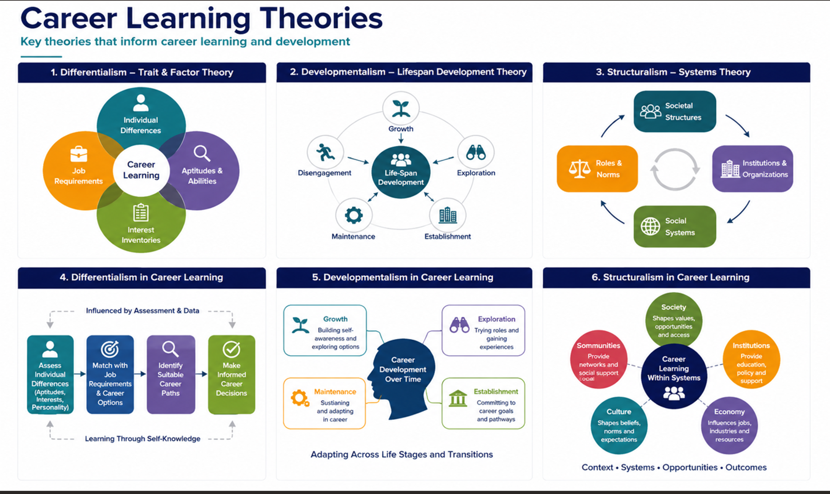
Modern Career Development Theory
Differentialism – Trait & Factor Theory
Developmentalism – Lifespan Development Theory
Structuralism – Systems Theory
Differentialism in Career Learning
Developmentalism in Career Learning
Structuralism in Career Learning
CDI Careers Leader Training | Core Day 2 | September 2026 9
Notes:
Introduce the Careers theories – the learners can make notes in their workbook pages 20 and 21

Slide 10
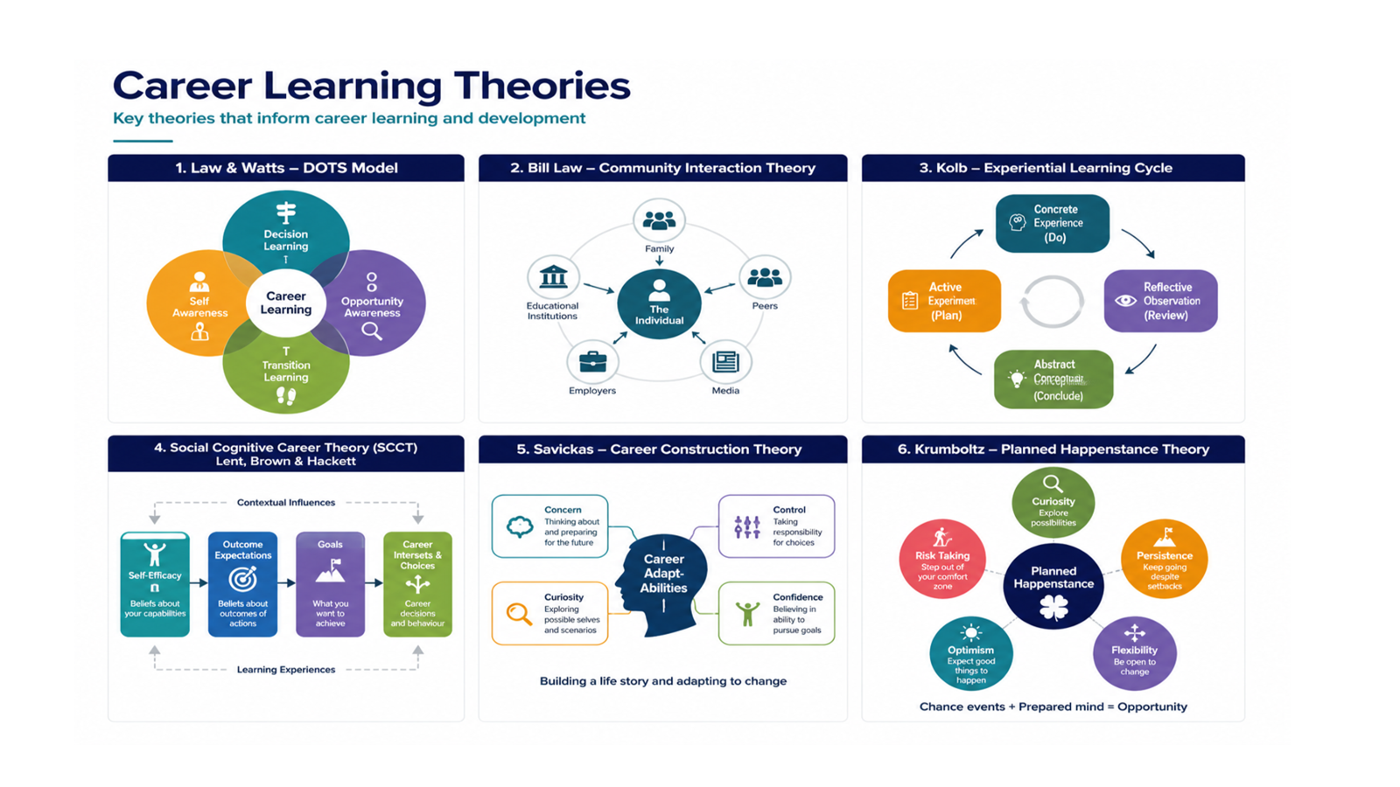
Law & Watts – DOTS Model
Bill Law – Community Interaction Theory
Kolb – Experiential Learning Cycle
Social Cognitive Career Theory (SCCT)
Lent, Brown & Hackett
Savickas – Career Construction Theory
Krumboltz – Planned Happenstance Theory

Slide 11
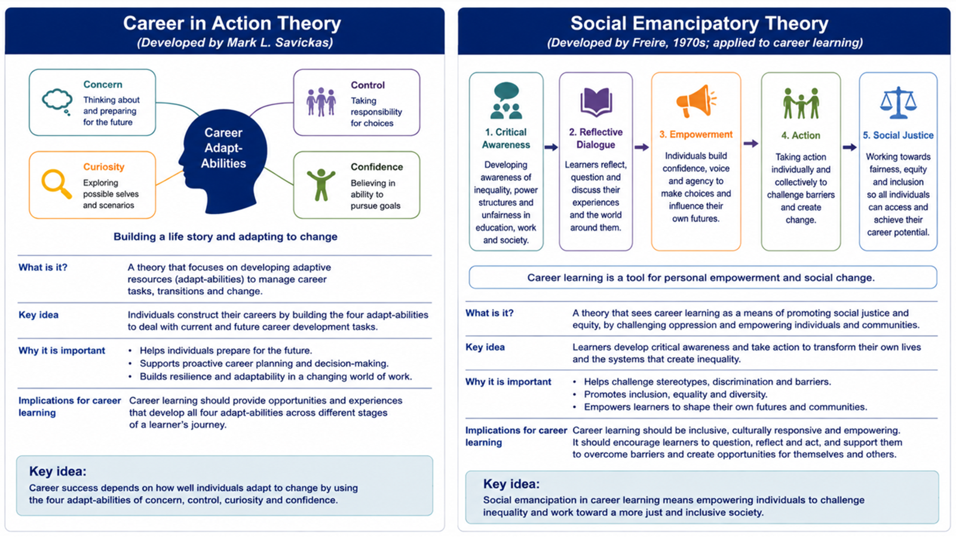

Slide 12
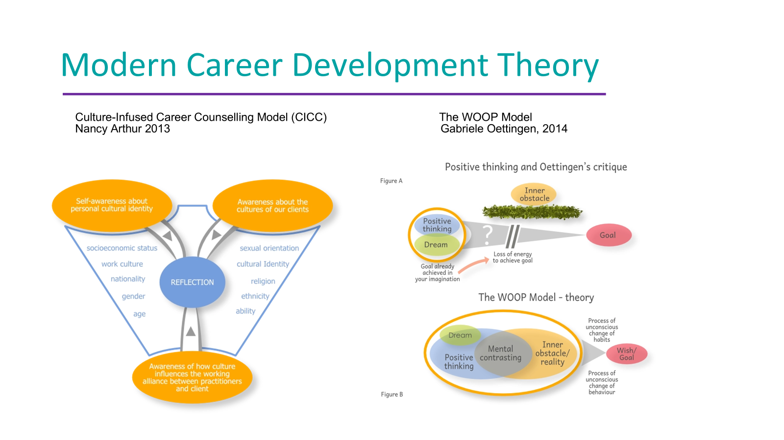

Slide 13
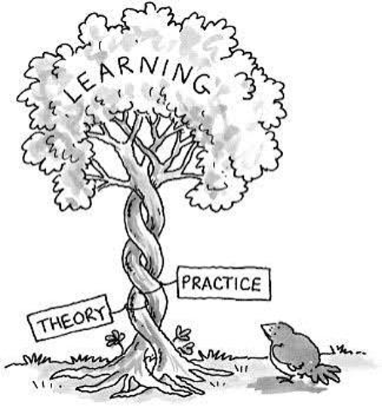
Theory into Practice
CDI Careers Leader Training | Core Day 2 | September 2026 10
Notes:
Ask delegates to apply the theory rather than simply define it. Choose one theory.
How could they apply it within their careers programme? What Activity, year group, intended learning outcome, evidence of impact. PG 22

Slide 14
Reflection
Which theory best supports your current programme?
CDI Careers Leader Training | Core Day 2 | September 2026 11
Notes:
Ask delegates to select the theory that best supports their current programme and explain why. Notes can be added to workbook PG 22

Slide 15
Labour Market Information
Why does it matter?
CDI Careers Leader Training | Core Day 2 | September 2026 13
Notes:
Introduce LMI and ask 'why does it matter?' before providing examples. Draw out informed choice, opportunity awareness and changing labour markets.

Slide 16
Understanding the full range of pathways
Education
Training
Employment
Self-Employment
Volunteering
Gap Year
Where and when do learners encounter these pathways within your programme?
Are there any gaps or points where one route is given greater prominence than another?
CDI Careers Leader Training | Core Day 2 | September 2026 14
Notes:
Use the six pathways as shown. Ask where and when learners encounter each route, and whether one is unintentionally privileged.

Slide 17
LMI in your Programme
1
2
Where is LMI currently incorporated?
Is it current?
3
4
local, regional and national?
accessible to different learners?
5
6
used progressively across year groups?
linked to curriculum learning?
7
8
used to challenge assumptions and stereotypes?
What would you improve?
CDI Careers Leader Training | Core Day 2 | September 2026 15
Notes:
Use the source questions as an audit. Ask delegates to identify one strength and one improvement.

Slide 18
LMI Activity
I want to be ………
CDI Careers Leader Training | Core Day 2 | September 2026 16
Notes:
Use the 'I want to be…' activity in the workbook PG 22. Ask delegates to consider a Career choice and then what LMI a learner would need to explore that aspiration. Think about the following: Current demand for that job role, Skills required, Qualifications, Salary, Local opportunities.

Slide 19





Nobody Delivers Careers Alone
Partnerships
SLT, Teaching & Support Staff
CDI Careers Leader Training | Core Day 2 | September 2026 17
Notes:
Transition from programme content to the people and organisations that help deliver it.

Slide 20
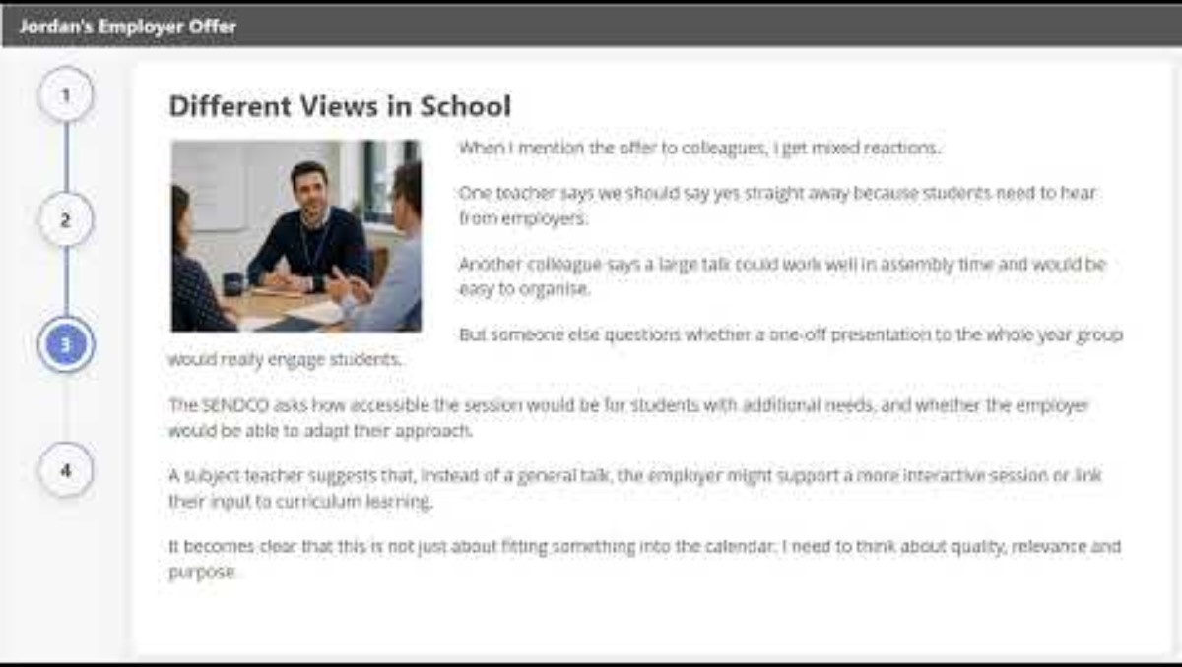
Partnerships in Practice – Activity
A local employer offers to come into school and give a general presentation to Year 10 about their company.
Purpose?
Learner need?
Preparation?
Follow-up?
CDI Careers Leader Training | Core Day 2 | September 2026 20
Notes:
Play the video: https://youtu.be/RpZotpnFYvI link is also embedded in the picture and it is written in the workbook PG23 . Ask how a general employer presentation could become a meaningful contribution: intended learner outcome, preparation, relevance, inclusion, follow-up and evaluation. Play the video. Then Working in small groups, can you answer the following questions:
What should Jordan find out from the employer before agreeing to the visit?
What should the intended learning outcomes be for Year 10 students?
How could Jordan work with the employer to make the encounter more meaningful and interactive?
What practical and inclusion issues should he think about before the session goes ahead?
Should Jordan accept the original idea of a general talk, adapt it, or suggest something different?

Slide 21
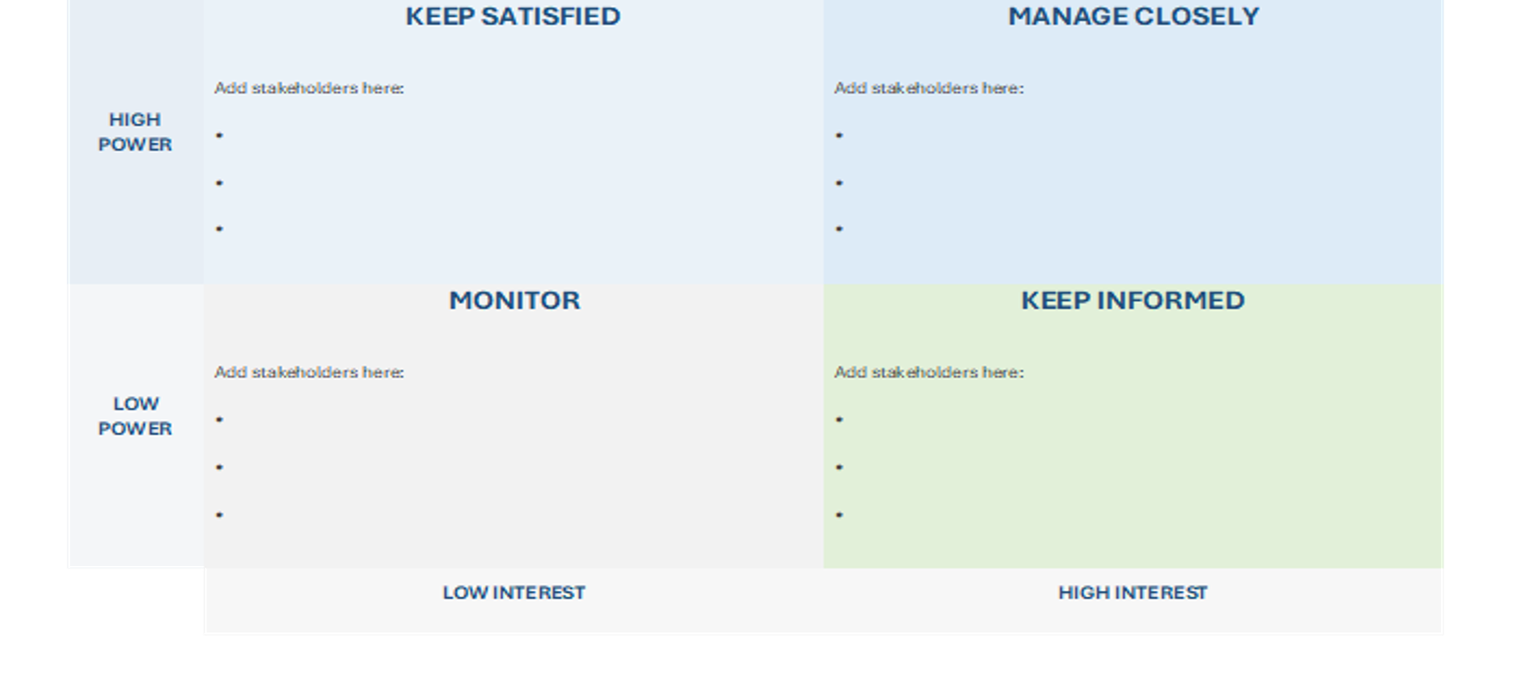
Power-Interest Grid
CDI Careers Leader Training | Core Day 2 | September 2026 21
Notes:
Use the Power Grid activity/resource. Explain power and interest at a basic stakeholder-planning level. There is an activity in the workbook PG 24 if you feel you have time.

Slide 22

Negotiating Partnerships
CDI Careers Leader Training | Core Day 2 | September 2026 22
Notes:
Introduce negotiation in the context of partnership working: clarifying purpose, roles, timing, resources and expectations. Keep this introductory; detailed negotiation is Extension content.

Slide 23
Reflection & Challenge
Key Learning
Three biggest takeaways.
CDI Careers Leader Training | Core Day 2 | September 2026 23
Notes:
Ask delegates to identify the three biggest takeaways from Day 2 and connect each to an action or programme-design decision.

Slide 24
Questions – Now that you have completed Day 2
Question 1
1. What's the most important thing you've learned from the session and your discussions today? Is there something you'd like to celebrate or recognise in your practice?
Question 2
2. Has today highlighted a gap or something you'd like to put in place? What, when and how?
Question 3
3. What support do you need from leadership or others to address immediate priorities? What discussions should you have with your line manager to move forward?
CDI Careers Leader Training | Core Day 2 | September 2026 24
Notes:
Allow time for the three reflection questions. Encourage delegates to record answers in their Reflections and Actions materials.

Slide 25
Next steps and moving forward
• How can you harness these ideas and make them part of your strategic careers plan?
• Now consider three strategic aims (you may want to create more) for planning your careers development programme.
CDI Careers Leader Training | Core Day 2 | September 2026 25
Notes:
Use the source next steps exactly. Ask delegates to translate today's ideas into their strategic careers plan and identify at least three strategic aims.

Slide 26
Accreditation & Assessment
Unit 18 Assessment Criteria - 18.2.1 / 18.2.2 https://youtu.be/xnb5vY-4NLw
Unit 19 Assessment Criteria - 19.1.1 / 19.1.2 - https://youtu.be/57j17Gdwgh8
Unit 19 Assessment Criteria - 19.5.1 - https://youtu.be/tRenBz1Sg9E
Unit 19 Assessment Criteria - 19.5.2 - https://youtu.be/y1mFsnxFpWo
CDI Careers Leader Training | Core Day 2 | September 2026 26

